Slide 1
BATTLE OF THE NEIGHBORHOODS
Applied Data Science Capstone

Slide 2
Introduction/Business Problem
Los Angeles is one of the most popular city in United States because of its renowned museums, unique hotels and vibrant multicultural neighborhoods. Los Angeles has a diverse economy and hosts businesses in a broad range of professional and cultural fields.
Being a popular city means it attracts thousands of tourists every year and thus tourism related business would be successful in L.A.
A travel agency wants to create travel packages by segregating different neighborhoods of the city so that they can recommend packages to their customers based on their interest and preferences such as –
Beaches and water sports
City Night life
Movie Studios
Hiking Trail etc
And also create a cluster map so that the customers can visualize it easily.

Slide 3
Data Acquisition
The data of Los Angeles city such as neighborhoods and their GPS co-ordinates was taken from Wikipedia.
https://en.wikipedia.org/wiki/Los_Angeles_County_Board_of_Supervisors
From the corresponding latitude and longitude data I used Foursquare application to get details on venues in and around the neighborhood.
Information on venues near the neighborhoods will be gathered from Foursquare.
I used the acquired location data to explore the nearby important and unique venues from the Foursquare API. Using the "explore" option, I look for top 10 venues in 10 km radius for each neighborhood and I get "Venue", "Venue Latitude", "Venue Longitude" and "Venue Category".

Slide 4
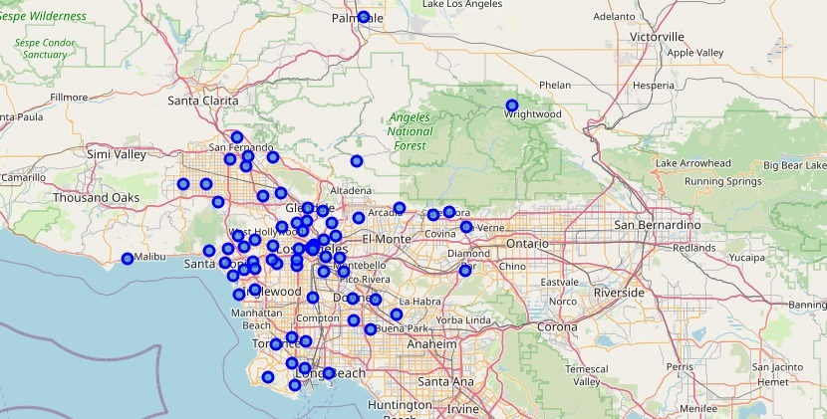
Los Angeles City Map

Slide 5
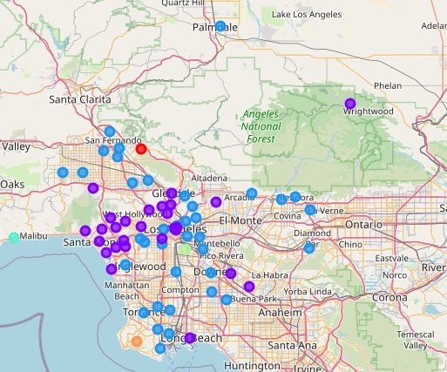
Cluster Map

Slide 6
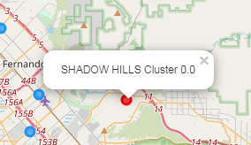
Cluster 0
This cluster has only one entry that is shadow hills, and the main venues are stables and movie studios.

Slide 7
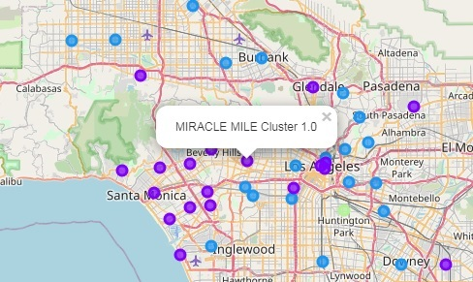
Cluster 1
This cluster has 27 neighborhoods with common venues as beaches and scenic spots along with glamorous part Los Angeles such as Downtown L.A, Long beach, and Santa Monica.

Slide 8
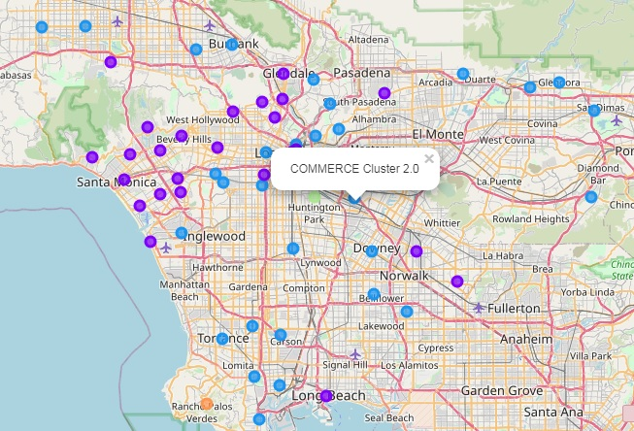
Cluster 2
This cluster has 37 neighborhoods; most of the common venues are restaurants, unique hotels, art gallery, museums etc and all of them are in the city centre.

Slide 9
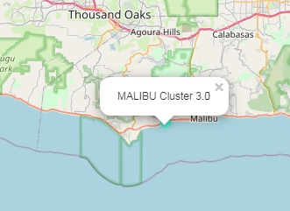
Cluster 3
Malibu is the only neighborhood in the cluster 3 because it’s the iconic destination for surfing, water sports and scenic beach.

Slide 10
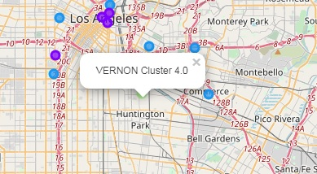
Cluster 4
Vernon is the only neighborhood in this cluster and it’s in city centre with no unique attractive spots for tourists however this place is good scouting for beginning a business venture or looking for an office.

Slide 11
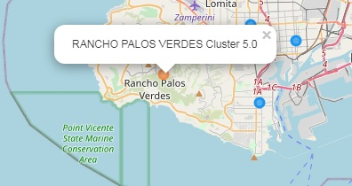
Cluster 5
Rancho Palos Verdes is the only neighborhood in cluster 5 and it is known for its nature park and hiking trails also located on a scenic coastline.

Slide 12
Conclusions and Discussions
There is further scope for this project if price or cost data for transportation, park entry fees etc is available and using that data, different economical packages can be made based on customer interests.
However I have done clustering only based on tourist choice of spots or common venues between different neighborhoods.
I would like to conclude by saying that people who have interests in movie studios, beaches and stables can go to cluster 0 and 1, people who have interests in art,music, night life will prefer cluster 2.
People who like water sports like surfing can visit the malibu which is the only neighborhood in cluster 3 and also people who love nature trails along a coast of a beatiful beach can visit the neighborhood in cluster 5.

Slide 13
Thank You!

